Slide 1
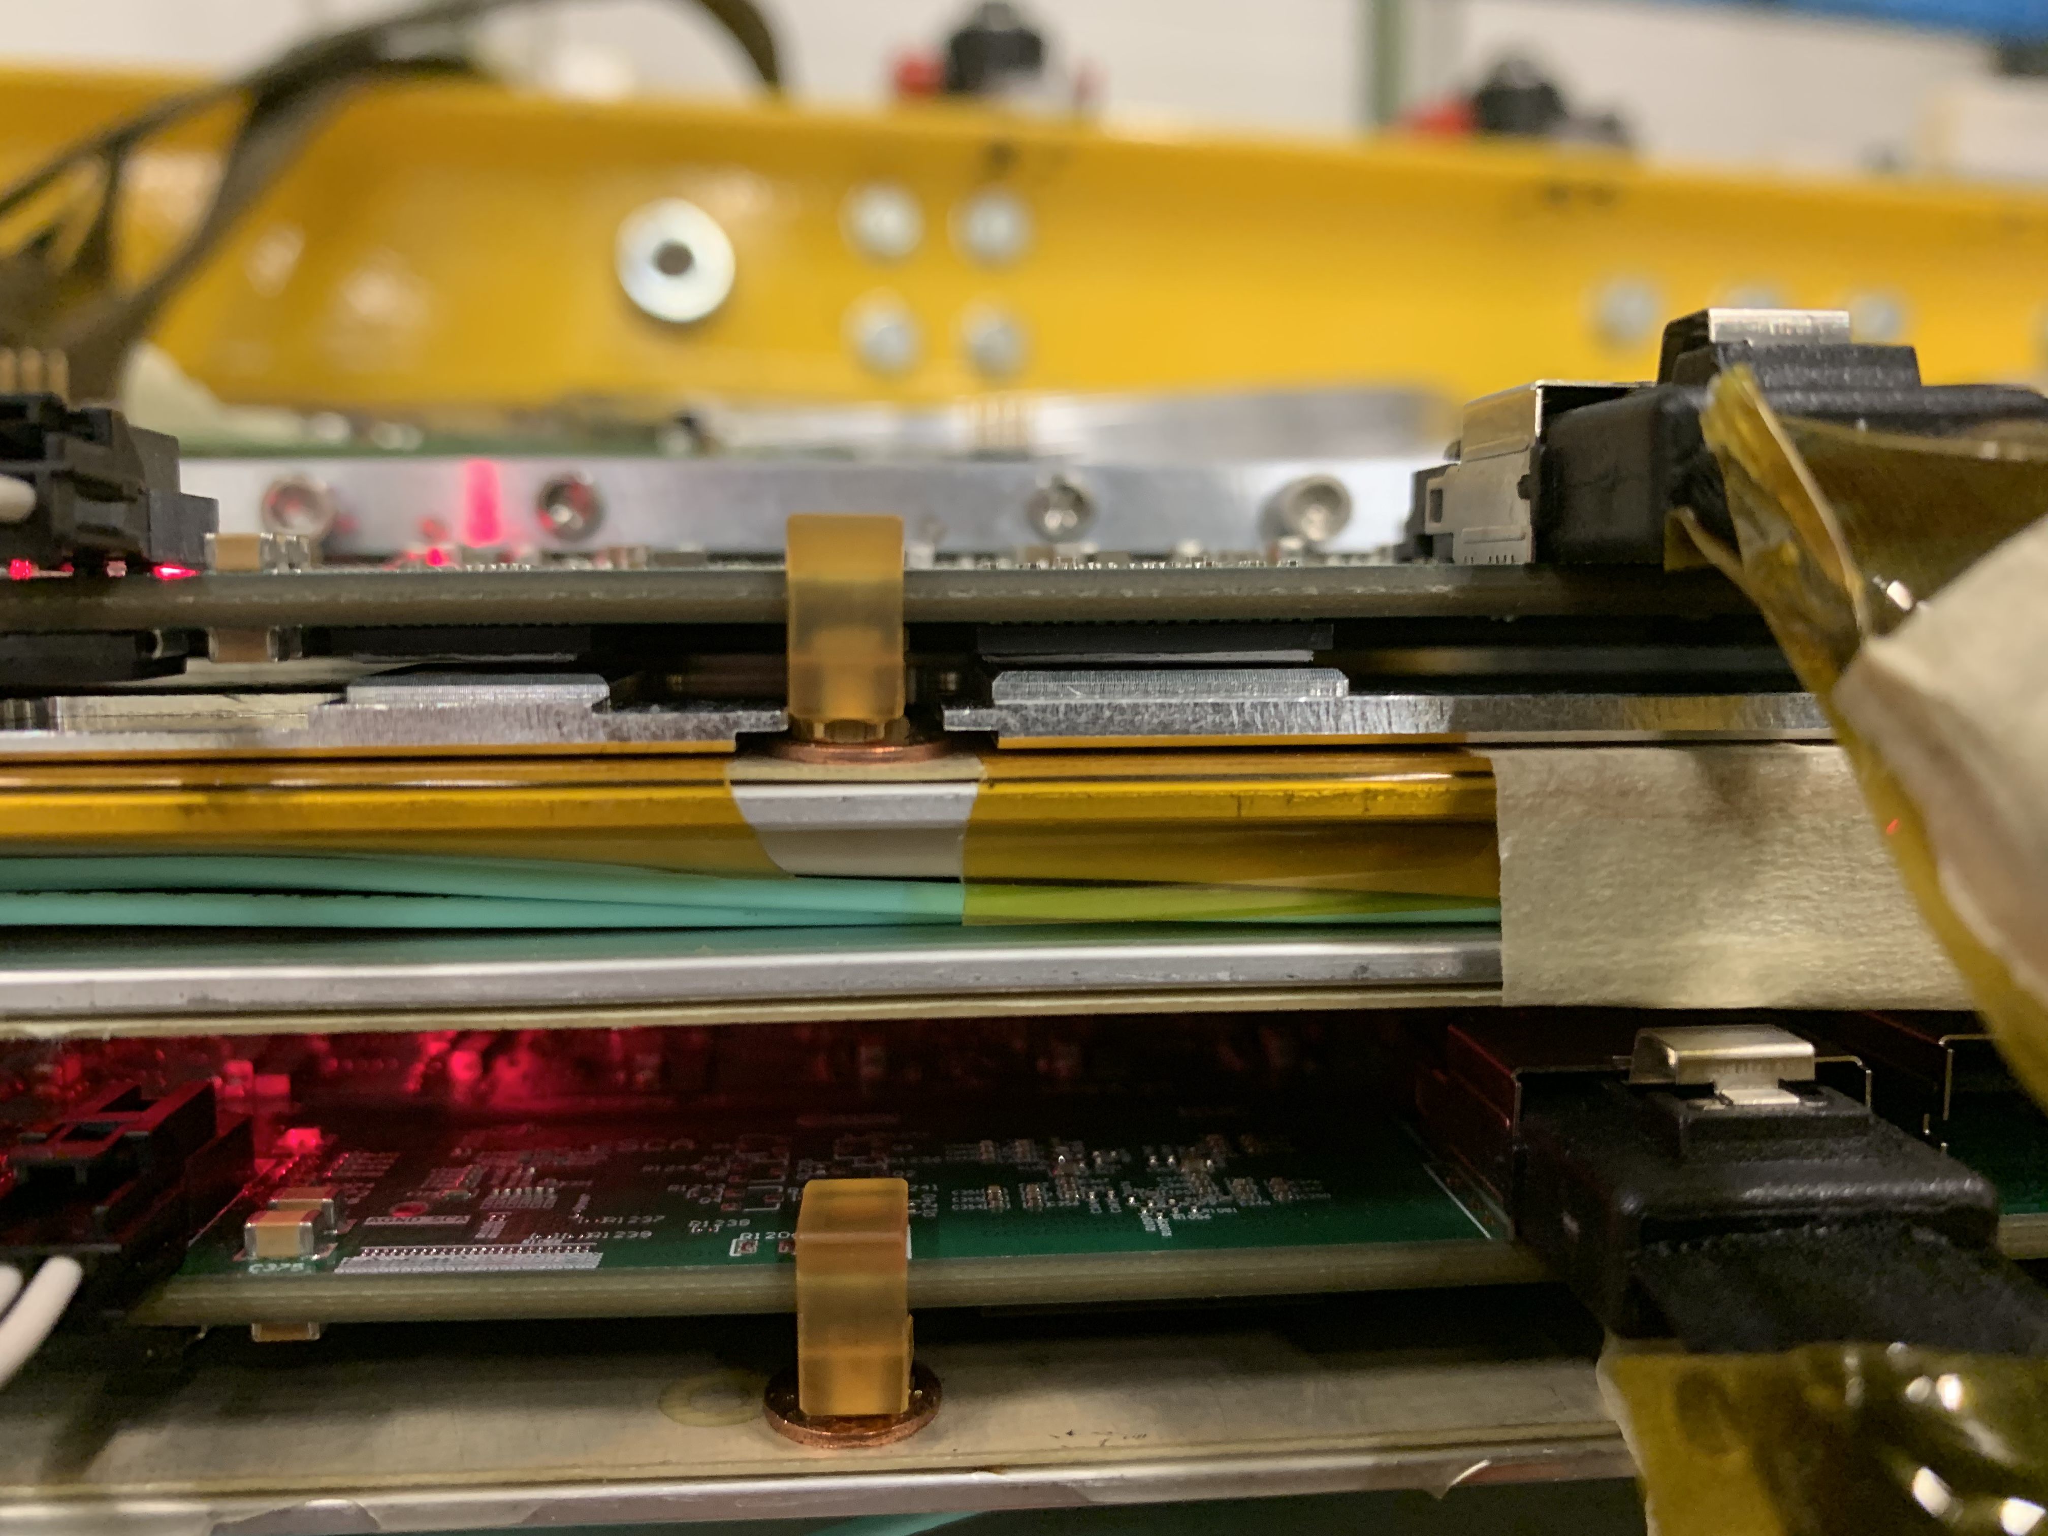
Week 3
Grey Conductive
Strip
Aluminum Cooling Plate
Recently Toby Zach and I learned about and helped assemble the cooling units for the MMFE8s.
The chamber itself is water cooled. There are water pipes running from a water cooling unit to a thin part of the chamber.
These carry water of about 16° C to the chamber.
The MMFE8s attach to the chamber using a series of conductive cooling pads attached to the cooling openings on the chamber which make contact with a milled aluminum cooling plate. There are also conductive pads connected to the MMFE8s, on each VMM, the ROC, and the SCA, as well as the underside of the 3 DCDC converters. Putting the cooling apparatus on the boards took their temperature down from about 60°C to 45°C by measurement of the thermal camera.
Washer

